Slide 1
Unsupervised Learning
Notes:
Continue our digression from neural networks for one more week
Last time we talked about non-parametric methods like nearest neighbors that rely on measuring distances between examples
This week, we’ll discuss unsupervised learning, which also depends on these distances

Slide 2
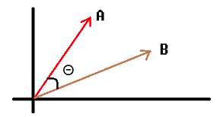
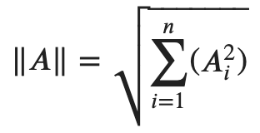
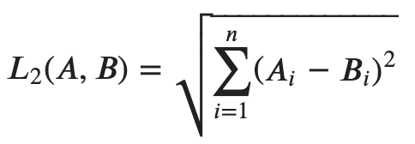
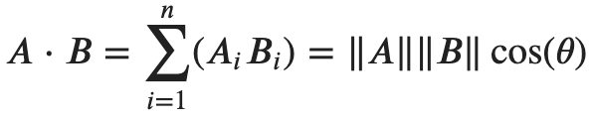
Distances Review
Notes:
A=(2,3) B=(4,2)
|A| = sqrt[2^2 + 3^2] = sqrt[4+9] = sqrt[13] = 3.6
|B| = sqrt[4^2 + 2^2] = sqrt(16+4] = sqrt[20] = 4.5
L2(A,B) = sqrt[(2-4)^2 + (3-2)^2] = sqrt[4 + 1] = 2.2
dot(A,B) = (2*4) + (3*2) = 8 + 6 = 14 -> 14/(3.6*4.5) = 0.86 -> arccos(.86) = 30 degrees

Slide 3
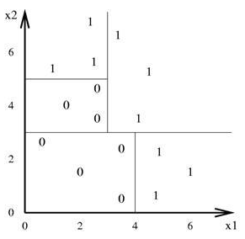
Supervised vs Unsupervised Learning
Supervised learning:
(X,Y) examples
Predict Y from X
Unsupervised learning:
(X) examples
Measure distances between examples of X

Slide 4
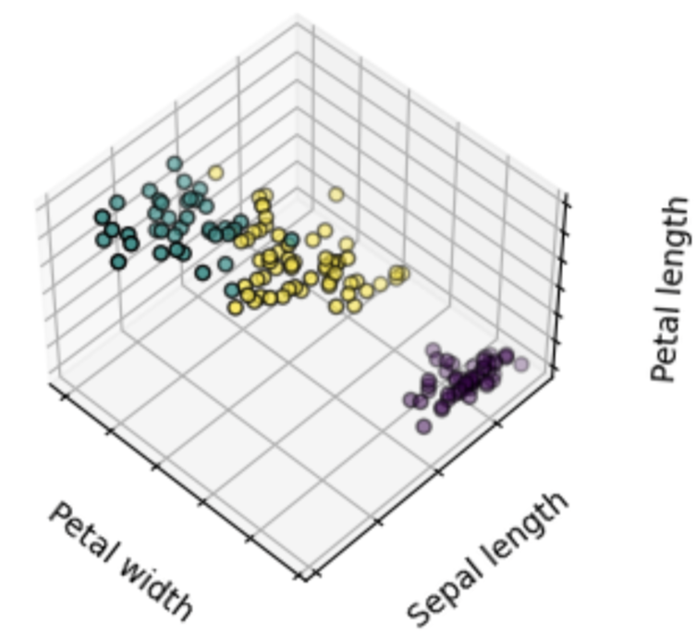
No Labels
Imagine you collect observations of some flowers
But don’t know their names

Slide 5
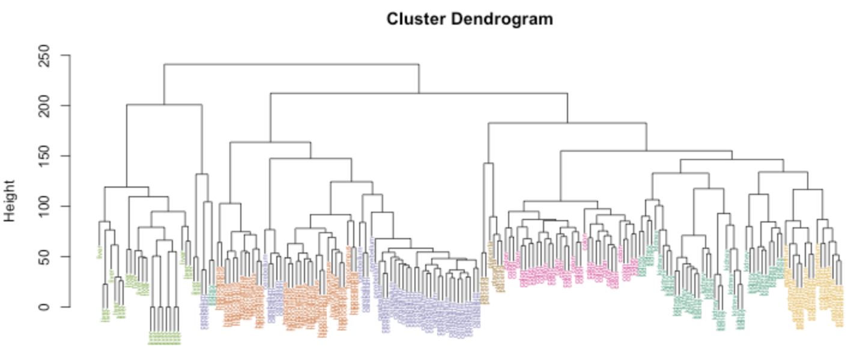
Unsupervised Learning
Understand data
Quantify outliers
Compress data
Select/manipulate features

Slide 6
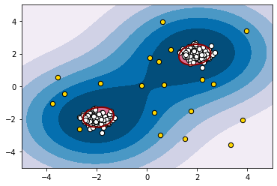
Unsupervised Learning
Understand data
Quantify outliers
Compress data
Select/manipulate features

Slide 7
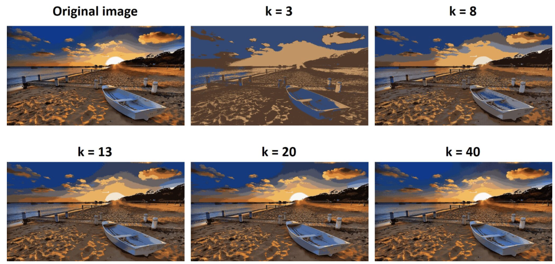
Unsupervised Learning
Understand data
Quantify outliers
Compress data
Select/manipulate features

Slide 8
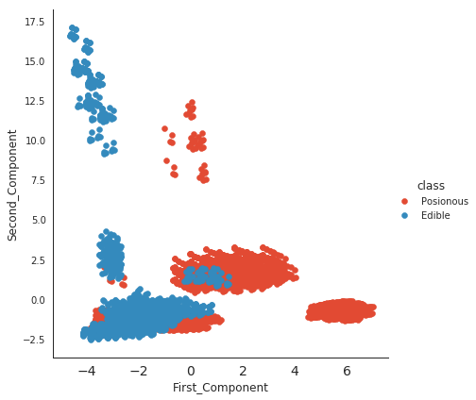
Unsupervised Learning
Understand data
Quantify outliers
Compress data
Select/manipulate features

Slide 9
Unsupervised Learning
Notes:
Q: [True/False] If vectors A and B have unit length, their dot product is the angle between them.
A: True

Slide 10
Agglomerative Clustering

Slide 11
Example: City Distances
 | Frankfurt | Hong Kong | London | Montreal | Moscow | New York | Tokyo
Frankfurt | 0 | 8277 | 400 | 3640 | 1253 | 3851 | 9776
Hong Kong | 8277 | 0 | 8252 | 10345 | 6063 | 10279 | 1788
London | 400 | 8252 | 0 | 3251 | 1557 | 3456 | 9536
Montreal | 3640 | 10345 | 3251 | 0 | 5259 | 330 | 8199
Moscow | 1253 | 6063 | 1557 | 5259 | 0 | 5620 | 4667
New York | 3851 | 10279 | 3456 | 330 | 5620 | 0 | 8133
Tokyo | 9776 | 1788 | 9536 | 8199 | 4667 | 8133 | 0
Notes:
this is really a toy example, but suppose we want to do some geographic clustering of cities
hierarchical clustering is based on pairwise distances

Slide 12
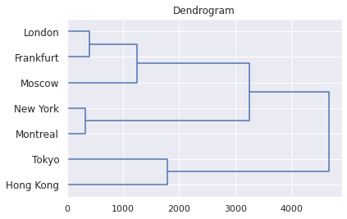
Agglomerative Clustering
Create a tree from distance measurements
Leaves are items
Nodes are clusters
Root contains all items
Notes:
Visualization is called a dendrogram (horizontal axis is distance between clusters)
Hong-Kong to Tokyo: 1788
In general, clustering items into a tree is called hierarchical clustering
Can construct it top-down (divisive) or bottom-up (agglomerative)

Slide 13
Agglomerative Clustering
Distance between clusters:
Min (single linkage)
Max (complete linkage)
Average
Notes:
Frankfurt - Moscow: 1253
London - Moscow: 1557

Slide 14
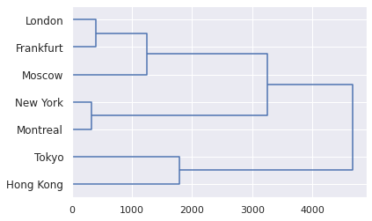
Example: City Distances
 | Frankfurt | Hong Kong | London | Montreal | Moscow | New York | Tokyo
Frankfurt | 0 | 8277 | 400 | 3640 | 1253 | 3851 | 9776
Hong Kong | 8277 | 0 | 8252 | 10345 | 6063 | 10279 | 1788
London | 400 | 8252 | 0 | 3251 | 1557 | 3456 | 9536
Montreal | 3640 | 10345 | 3251 | 0 | 5259 | 330 | 8199
Moscow | 1253 | 6063 | 1557 | 5259 | 0 | 5620 | 4667
New York | 3851 | 10279 | 3456 | 330 | 5620 | 0 | 8133
Tokyo | 9776 | 1788 | 9536 | 8199 | 4667 | 8133 | 0
Merge closest items: (Montreal, New York)

Slide 15
Example: City Distances
 | Mnt/NY | Frankfurt | Hong Kong | London | Moscow | Tokyo
Mnt/NY | 0 | 3640 | 10279 | 3251 | 5259 | 8133
Frankfurt | 3640 | 0 | 8277 | 400 | 1253 | 9776
Hong Kong | 10279 | 8277 | 0 | 8252 | 6063 | 1788
London | 3251 | 400 | 8252 | 0 | 1557 | 9536
Moscow | 5259 | 1253 | 6063 | 1557 | 0 | 4667
Tokyo | 8133 | 9776 | 1788 | 9536 | 4667 | 0
Merge closest items: (Frankfurt, London)

Slide 16
Example: City Distances
 | Frt/Lnd | Mnt/NY | Hong Kong | Moscow | Tokyo
Frt/Lnd | 0 | 3251 | 8252 | 1253 | 9536
Mnt/NY | 3251 | 0 | 10279 | 5259 | 8133
Hong Kong | 8252 | 10279 | 0 | 6063 | 1788
Moscow | 1253 | 5259 | 6063 | 0 | 4667
Tokyo | 9536 | 8133 | 1788 | 4667 | 0
Merge closest items: (Frankfurt/London, Moscow)

Slide 17
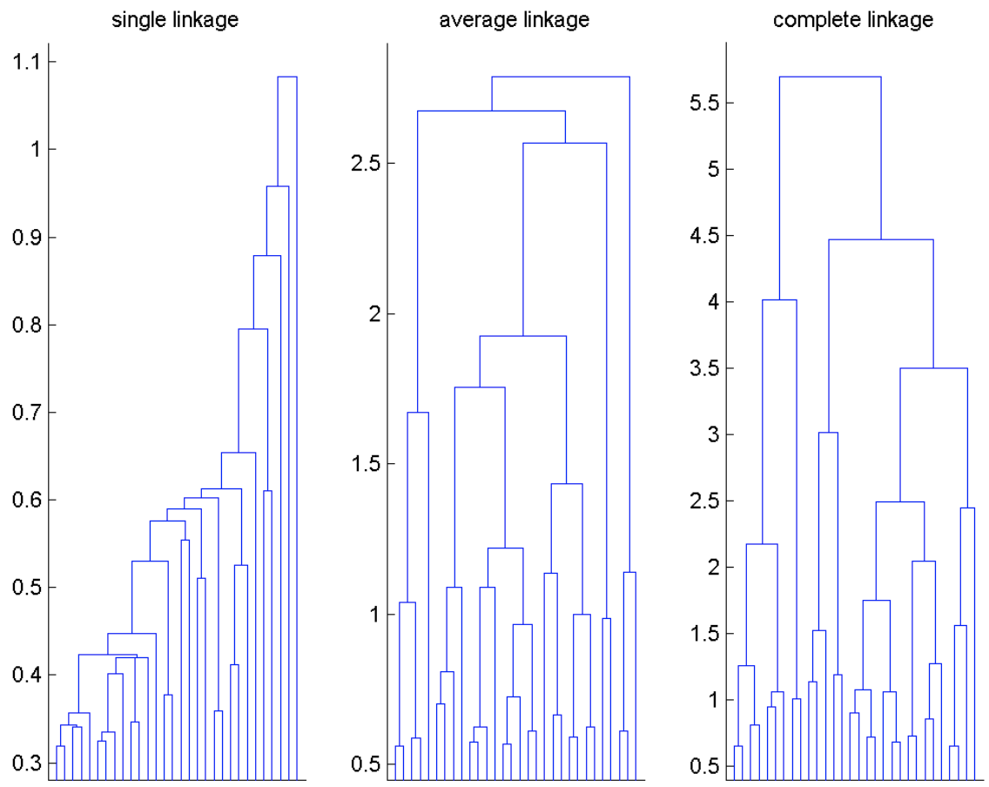
Comparing Linkage Functions
Single: chaining behavior
Complete: crowding behavior
Average: more balance
Notes:
[draw 2 clusters, show single vs complete]
crowding -- end up with points closer to other clusters than their own cluster

Slide 18
Agglomerative Clustering
Notes:
Q: [True/False] Single linkage refers to the method of linking two clusters based on their most distant items.
A: False

Slide 19
K-Means

Slide 20
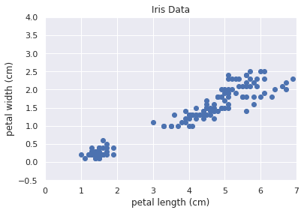
Partitioning
Hierarchical clustering
Partitioning

Slide 21
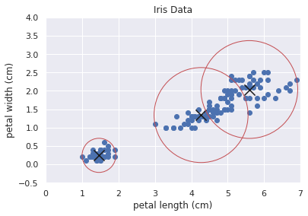
Partitioning
Hierarchical clustering
Partitioning
Assignment of items to clusters

Slide 22
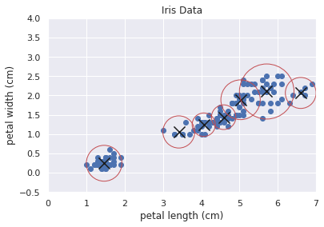
Partitioning
Hierarchical clustering
Partitioning
Assignment of items to clusters
Given some fixed number of clusters

Slide 23
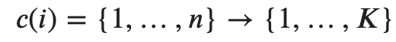
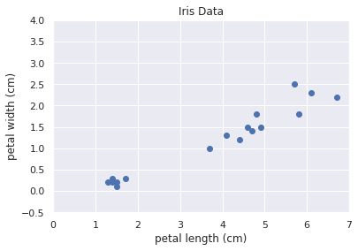
Quantifying Clusters
Assignment of items to K clusters
Notes:
each of n items assigned to 1 of K clusters

Slide 24
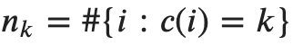
Quantifying Clusters
Assignment of items to K clusters
Number of items in cluster k

Slide 25
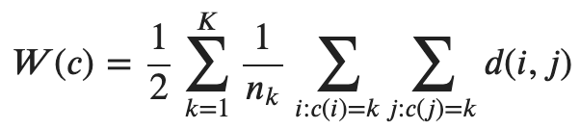
Quantifying Clusters
Assignment of items to K clusters
Number of items in cluster k
Within cluster scatter; we want to minimize this

Slide 26
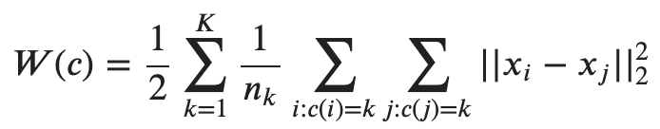
Quantifying Clusters
Rewrite distance as L2

Slide 27
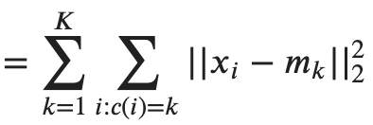
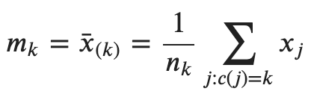
Quantifying Clusters
Rewrite distance as L2
Use a centroid for each cluster

Slide 28
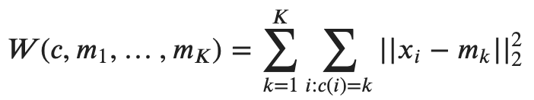
K-Means Algorithm
Minimize W by alternately minimizing over c and m:
(0) Initialize with some centroids m
(1) Update c by assigning each item to its closest centroid
(2) Update m by computing an average over items assigned to each centroid
(3) Iterate steps (2) and (3) to convergence

Slide 29
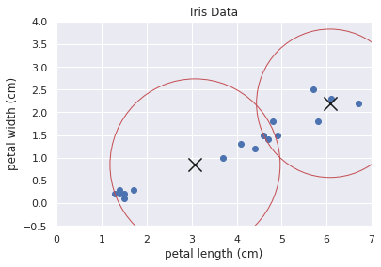
K-Means Algorithm
Minimize W by alternately minimizing over c and m:
(0) Initialize with some centroids m
(1) Update c by assigning each item to its closest centroid
(2) Update m by computing an average over items assigned to each centroid
(3) Iterate steps (2) and (3) to convergence

Slide 30
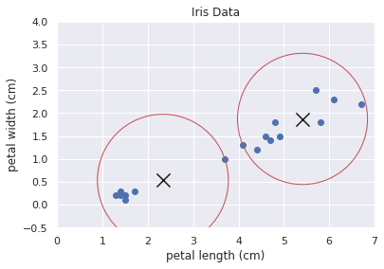
K-Means Algorithm
Minimize W by alternately minimizing over c and m:
(0) Initialize with some centroids m
(1) Update c by assigning each item to its closest centroid
(2) Update m by computing an average over items assigned to each centroid
(3) Iterate steps (2) and (3) to convergence

Slide 31
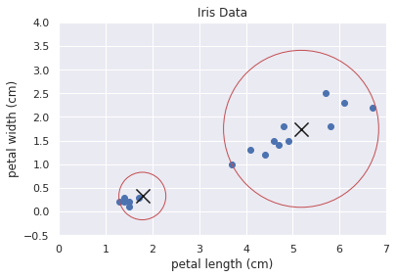
K-Means Algorithm
Minimize W by alternately minimizing over c and m:
(0) Initialize with some centroids m
(1) Update c by assigning each item to its closest centroid
(2) Update m by computing an average over items assigned to each centroid
(3) Iterate steps (2) and (3) to convergence

Slide 32
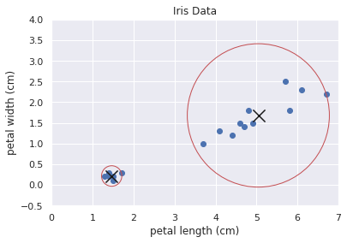
K-Means Algorithm
Minimize W by alternately minimizing over c and m:
(0) Initialize with some centroids m
(1) Update c by assigning each item to its closest centroid
(2) Update m by computing an average over items assigned to each centroid
(3) Iterate steps (2) and (3) to convergence

Slide 33
K-Means Properties
W is guaranteed to decrease after each iteration
Algorithm always converges to a local minimum
Sensitive to initialization

Slide 34
K-Means
Notes:
Q: [True/False] The K-Means algorithm selects an appropriate number of clusters.
A: False

Slide 35
K-Means for Quantization

Slide 36
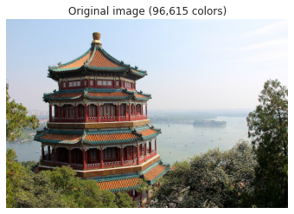
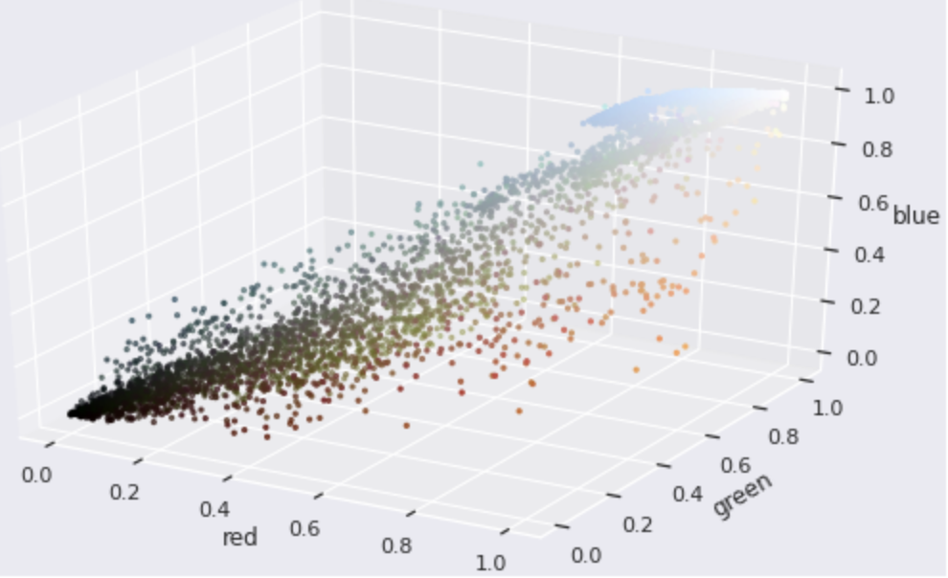
Image Color Quantization
RGB values: [red, green, blue]
128 values per color = 3 bytes per pixel = ~16M colors

Slide 37
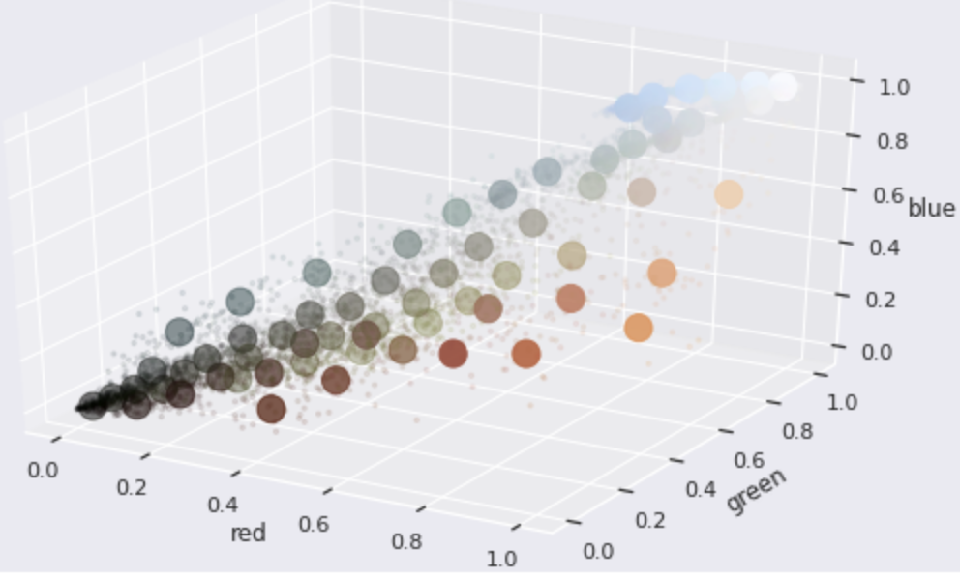
Image Color Quantization
K-Means with k=64

Slide 38
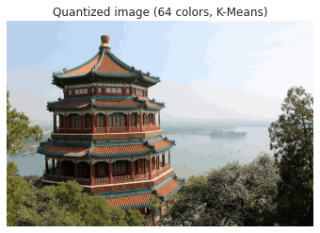
Image Color Quantization
427*640*3 = 819840 bytes
427*640*0.5 = 136640 bytes

Slide 39
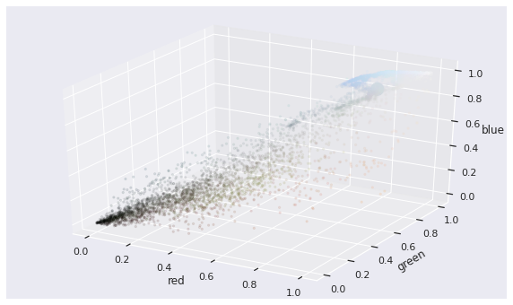
Image Color Quantization
K-Means with k=2

Slide 40
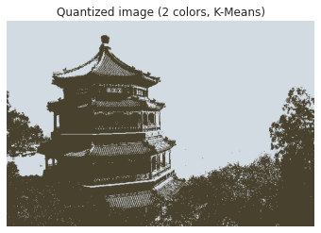
Image Color Quantization
427*640*3 = 819840 bytes
427*640*0.125 = 34160 bytes

Slide 41
Vector Quantization
Signal processing / density estimation
Lossy data compression
Codebook maps items to a smaller set of IDs
K-Means is one way to build the codebook

Slide 42
K-Means for Quantization
Notes:
Q: [True/False] K-Means for color quantization maps RGB values to a small set of representative colors.
A: True

Slide 43
The Normal Distribution

Slide 44
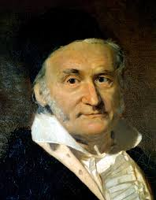
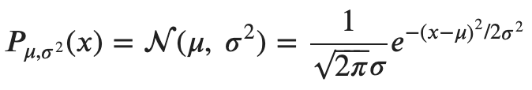
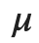
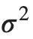
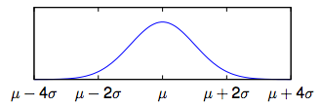
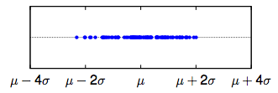
The Normal (Gaussian) Distribution
mean (center of the data)
variance (spread of the data)
Carl Friedrich Gauss
1777 - 1855
Notes:
The normal distribution is often attributed to Gauss. While Gauss was one of the greatest mathematicians of all time, making significant contributions in 12 different fields from number theory to geophysics, he wasn’t the first to describe this particular distribution. Actually a number of different mathematicians worked out the idea independently, though perhaps Laplace was the first.
Still, the name Gaussian stuck, so I’ll try to use Gaussian and Normal distribution interchangeably.
The normal distribution is described by 2 parameters, the mean mu and the variance sigma^2 (sigma is called the standard deviation).

Slide 45
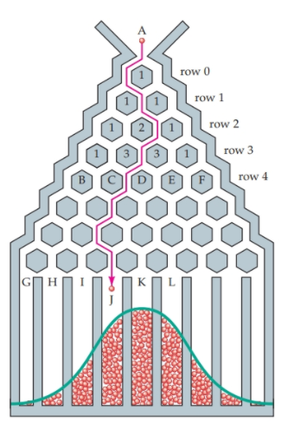
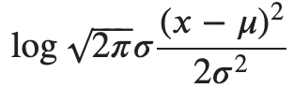
Normal Distribution Properties
Central Limit Theorem: the sum of samples from any random variable tends to look normally distributed.
Sums and differences of Normal distributions are also Normal.
Negative log of the probability density function (PDF) looks like weighted Euclidean distance
[source]
Notes:
The normal distribution has a number of important properties. Perhaps most importantly, it is at the heart of the central limit theorem. This says that you can take any distribution, start taking samples, add them up, and the result will follow a normal distribution.
Try, for example, a uniform distribution over numbers between 0 and 1. Sum 100 samples over and over and draw a histogram of the result. It will look just like your friend Gauss.
If you’ve ever been to the science museum in Boston, there’s a very nice demonstration of the central limit theorem. It’s called the bean machine or a Galton Box after its inventor Sir Francis Galton. The idea is that a ball is dropped into a grid of pins. At each pin, the ball can go left or right with equal probability (a draw from a binomial distribution). As it makes its way to the bottom, it ends up in a bin that represents the sum of these draws. The more balls pass through the machine, the more the resulting distribution resembles the normal distribution.
Another nice property is that the sum of 2 Gaussian random variables is also a Gaussian random variable. This makes a lot of math with Gaussians simple.
Finally, it’s interesting to observe that the negative log of the Gaussian probability function looks like a scaled version of the Euclidean distance.
Remember one problem with nearest neighbors is its dependence on a distance metric, which tends to weight each feature equally. The Gaussian distribution allows us to scale each feature by its own variance.

Slide 46
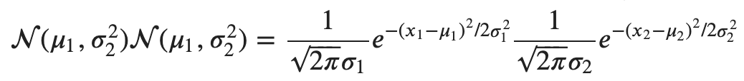
Normal Distribution in 2-D
Let r be the correlation between the two random variables:
If r=0, we can simplify:
Notes:
Next let’s look at the 2-dimensional normal probability function. If you’d like, you can think of this as a joint distribution over 2 random variables, one for each dimension.
If the 2 dimensions are correlated -- here, r > 0 -- the function gets a bit complicated. The exponential includes (x1 - mu1)^2, (x2-mu2)^2, and a term for the interaction between x1 and x2.
In the special case where r=0, the joint distribution factors into the product of two 1-dimensional Gaussians.

Slide 47
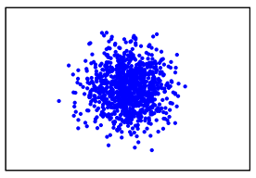
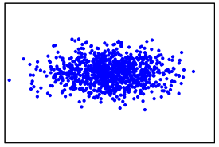
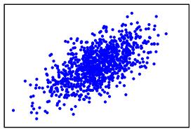
Correlations in 2-D
r=0; equal variance
r=0; unequal variance
r>0; unequal variance

Slide 48
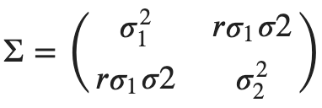
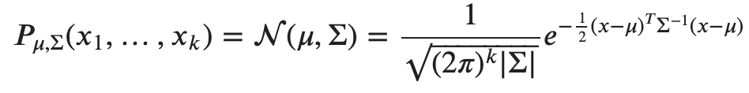
Multivariate Normal
In 2 dimensions, we define the covariance matrix:
Here’s the general multivariate probability density function:

Slide 49
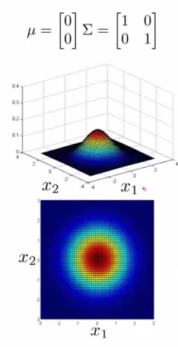
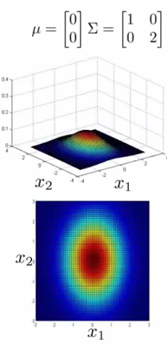

2-D Normal Distribution Examples
[source]

Slide 50
The Normal Distribution
Notes:
Q: A 3-D Normal distribution has how many parameters?
A: 9

Slide 51
Normal Parameter Estimation

Slide 52



Maximum Likelihood
Assuming our model form is correct,
Choose parameters that maximize the probability (likelihood) of the data
Maximum Likelihood Estimates are the best we can do given infinite data
1033 Major League Baseball players
x₂: Weight (pounds)
[source]
We want:
x₁: Height (inches)

Slide 53





Univariate Estimation
1033 Major League Baseball players
x₂: Weight (pounds)
x₁: Height (inches)

Slide 54



Multivariate Estimation
1033 Major League Baseball players
x₂: Weight (pounds)
x₁: Height (inches)

Slide 55
Normal Parameter Estimation
Notes:
Q: [True/False] Estimating all the parameters of a multivariate Normal via Maximum Likelihood can be done in just 2 passes through the data.
A: True

Slide 56
Gaussian Mixture Models

Slide 57



Gaussian Mixtures
Not all data is Normally distributed
Can use a mixture of Normals:

Slide 58

GMM Density
The probability of each observation is a weighted combination of Gaussians:
Component weights p are multinomial
Can approximate any distribution… with enough Gaussians

Slide 59
GMM Generative Process
Pick a component j from multinomial p
Generate a data point x_{i} with probability given by N(µ_{j}, Σ_{j})

Slide 60


GMM Generation Example
Speech data (in 2 dimensions), modeled with a 10-component GMM:
Real speech data
Sample from GMM

Slide 61
MLE for GMMs
Need to estimate means, (co-)variances, and mixture weights
Mixture weights are hidden variables
No straightforward way to get the argmax over parameters

Slide 62
Gaussian Mixture Models
Notes:
Q: A full-covariance GMM in 3 dimensions with 3 components has how many parameters?
A: 30

Slide 63
GMM Parameter Estimation

Slide 64
Hidden Variables
Suppose we had a cluster assignment for each data point;
Now we can get the MLE for the GMM parameters!
Given Gaussian parameters, we can generate cluster assignments
Sounds like the K-Means algorithm
Notes:
So mixtures of Gaussians give us lots more modeling power, but the resulting hidden variables make training tricky. What can we do?
Notice that if we happened to be told the cluster assignment for each data point (as in the picture here), then we know how to estimate the Gaussian parameters. We just use purple points to estimate Gaussian 1 and the yellow points to estimate Gaussian 2.
Also, notice that if we have 2 parameterized Gaussians, we can pick up a data point, and get the probability that it was generated by Gaussian 1 and the probability that it was generated by Gaussian 2. In this way, we can create a new cluster assignment.
This sounds a lot like k-means. Switch off between assignment and estimating means.

Slide 65
Expectation Maximization (EM)
Hard assignment:
Assign a single cluster for each x_{i}
Similar to K-Means
Convergence guarantees don’t hold
Soft assignment:
x_{i} gets a partial assignment to each cluster j
Also called “fractional counts”
Parameters converge to local optimum

Slide 66


GMM Example
10 data points
Initial parameter values
Training data;
Densities of initial Gaussians

Slide 67

GMM Example: Expectation Step
Notes:
Ok, here’s a whole bunch of numbers. The first column is our data.
The second column is the posterior probability of the data point given Gaussian #1 and then Gaussian #2.
The third column is the sum of those 2 posteriors, which we use to normalize, to get the fractional counts in column 4: the probability that the data was generated by each Gaussian.
Note that I’m using the variable “h” to index the Gaussians.

Slide 68



GMM Example: Maximization Step
Estimate means from fractional counts:
Similar for variances
Notes:
Now we have fractional counts for each data point -- reflecting our belief about the hidden variables. So we can return to the problem of estimating the Gaussian parameters.
We can use our old familiar maximum likelihood estimators, but with a slight modification. Each point is weighted by its fractional count.

Slide 69

GMM Example: Mixture Weights
Estimate means from fractional counts:

Slide 70



GMM Example: Iterations
Notes:
Take a look at how EM alters the parameters over 10 iterations.
It quickly realizes that the prior probability on Gaussian #1 (on the left) is higher, eventually settling on 0.7 and 0.3 as the mixture weights.
However, the variance of Gaussian #2 (on the right) is a bit trickier. At first, EM prefers a smoother interpretation of the data: 2 broader overlapping distributions.
Eventually, though it converges on a much more peaked interpretation: attributing the data on the left mostly to Gaussian #1 and the data on the right mostly to Gaussian #1.
This is a general property of mixture models. The maximum likelihood parameters tend to be peaked rather than smooth. Afterall, remember that the generative process involves first picking a component and then sampling from its distribution.

Slide 71
GMM Parameter Estimation
Notes:
Q: [True/False] The EM algorithm with soft assignment means that every data point is assigned a single Gaussian component in each Expectation step.
A: False

Slide 72
Dimensionality Reduction

Slide 73

Singular Value Decomposition (SVD)
Factorization of any rectangular matrix
Sigma contains singular values
U and V contain singular vectors
Can reconstruct the original data matrix M from this product

Slide 74

SVD for Dimensionality Reduction

Slide 75
SVD for Dimensionality Reduction
Sepal Length | Sepal Width | Petal Length | Petal Width
5.1 | 3.5 | 1.4 | 0.2
7.0 | 3.2 | 4.7 | 1.4
6.3 | 3.3 | 6.0 | 2.5
... | ... | ... | ...
Label
0
1
2
...
Iris data: (150x4)

Slide 76
SVD for Dimensionality Reduction
Sepal Length | Sepal Width | Petal Length | Petal Width
5.1 | 3.5 | 1.4 | 0.2
7.0 | 3.2 | 4.7 | 1.4
6.3 | 3.3 | 6.0 | 2.5
... | ... | ... | ...
Label
0
1
2
...
Iris data: (150x4)
u,s,v = np.linalg.svd(iris_data, full_matrices=False)
transformed = u[:, 0:2] * s[0:2]
reconstructed = np.matmul(transformed, v[0:2, :])

Slide 77
SVD for Dimensionality Reduction
Sepal Length | Sepal Width | Petal Length | Petal Width
5.1 | 3.5 | 1.4 | 0.2
7.0 | 3.2 | 4.7 | 1.4
6.3 | 3.3 | 6.0 | 2.5
... | ... | ... | ...
Label
0
1
2
...
Iris data: (150x4)
u,s,v = np.linalg.svd(iris_data, full_matrices=False)
transformed = u[:, 0:2] * s[0:2]
reconstructed = np.matmul(transformed, v[0:2, :])
original [5.100 3.500 1.400 0.200]
transformed [-5.913 2.302]
reconstructed [5.095 3.506 1.402 0.202]

Slide 78

SVD for Dimensionality Reduction
First 2 features in the original data
No clear separation among classes

Slide 79

SVD for Dimensionality Reduction
First 2 features in the original data
No clear separation among classes
2 transformed features (using SVD)
Capture more than 90% of variance

Slide 80
Why Reduce Dimensions?
Remove noise (unwanted variance) from the data
Reduce the number of features and thus model complexity
Help visualize relationships

Slide 81


tSNE for Visualization
[source]

Slide 82
Dimensionality Reduction
Notes:
Q: [True/False] The SVD can be used to approximately reconstruct a data matrix M from a small set of (transformed) features.
A: True

